Slide 1
Administration Code Training
703 KAR 5:080
Office of Assessment and Accountability
Notes:
This training will discuss the Administration Code Regulation 703 KAR 5:080. This training must be completed prior to administrating any state-required or optional assessments that are used in accountability, which include:
•KSA
•AKSA
•WIDA ACCESS and WIDA Alternate Access for ELLs
•College Admissions Exam
•CTE EOP and CTE Industry Certification Exams
•And others
If you are providing accommodations for students with an IEP, 504 Plan, or PSP, you will also need to review the Inclusion of Special Populations training.
Each section has been broken down into training modules. Please ensure to review all five modules for the complete Administration Code training.

Slide 2
Module 2
Classroom Materials (walls and displays)
Resource Guidelines
Calculators
Electronic Devices
Allegation Prevention/Best Practices
Check for Understanding 2
Notes:
Module 2 will discuss classroom materials and resource guidelines including calculators and electronic devices. There will be some allegation prevention and best practices tips and a check for understanding at the end of the module.

Slide 3
Classroom Materials
Classroom Displays (walls, bulletin boards, decorations)
Calculators
Electronic Devices
Notes:
Resources and materials available to students during testing are dependent upon the assessment. Please check the test administration manual for further guidance on what should be at a student workstation during testing.

Slide 4
Walls and Bulletin Boards _{p.7-8}
Acceptable | Not Acceptable
Placing materials on classroom walls and bulletin boards for instructional purposes anytime during the year _{p.7} | Leaving materials containing content information or strategies for solving problems on classroom walls, bulletin boards, or other surfaces (e.g., ceilings, floors, blinds, windows, and clothing) during testing sessions. _{p.7}
Leaving periodic tables or materials without content or strategies for solving problems uncovered _{p.8}
Notes:
Testing room surfaces should be free of content information or strategies for solving problems during operational and field testing. Yes, this means bulletin boards…and walls…all surfaces.
It is Acceptable to place instructional materials on bulletin boards, walls, etc., throughout the year, but when the room is used for testing, those same content materials must be removed or covered. Covered means with a covering that is opaque and not see-through.
Examples of materials that may not be displayed during assessments include anything that may contain relevant content information or strategies for solving problems. These materials may be anywhere in the room: walls, ceilings, floors, windows, and clothing (yes, clothing). The purpose of this is to make sure that all students have access to the same resources and nobody has an advantage over others.
Let’s look closer at some of these materials.

Slide 5
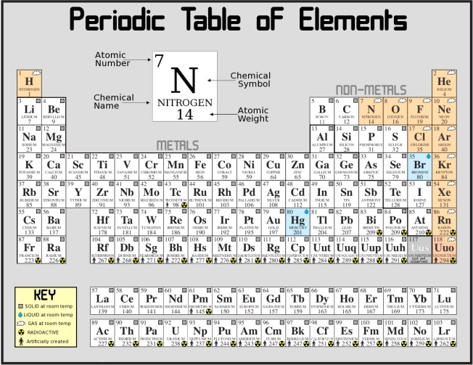
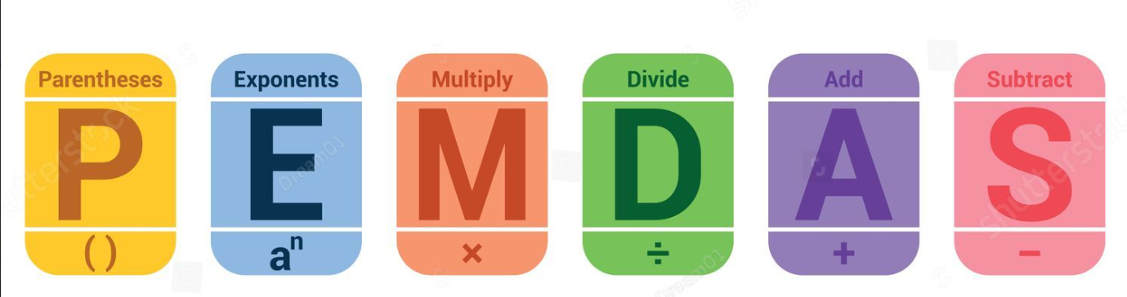



Posters, Decorations, Displays _{p.8}
ACCEPTABLE | NOT ACCEPTABLE
Notes:
Motivational posters or materials without content and standard periodic tables can remain on the walls. Periodic tables are listed in the regulation as being acceptable and accessing one does not give an advantage if the student does not understand how to read a periodic table.
​
The materials on the right are acceptable during instruction but must be covered up during assessment. These are examples of materials that contain content, problem-solving strategies, processes, etc., are unacceptable for display or use during testing sessions. Even things painted on the walls that could be considered content, three-dimensional sculptures or paintings used in a lesson must be covered. Calendars and classroom schedules are included because they can be used as number lines.

Slide 6
Resource Guidelines _{p.8-9}
Acceptable | Not Acceptable
At the student’s request, providing resources in the testing environment that are specified in a student’s IEP, 504 Plan or PSP that are consistent with instructional strategies _{p.8} | Providing any resources not listed in the administration manuals during testing _{p.8}
Making available blank writing or graph paper, blank (clear or colored) overlay sheets and bookmarks free of content at student workstations _{p.9} | Distributing, making available, or attaching to students’ workstations any information or materials that are not sent as part of the assessment materials or specified in the test administration manuals. _{p. 8}
Notes:
During assessments, administrators must not provide or allow access to any materials not included in the assessment materials or test administration manuals. Prohibited items include acronym sheets, answer organization tools, textbooks, and printed writing rubrics. Students with an IEP, 504 or PSP plan may be allowed resources consistent with instructional strategies. Check with your BAC for accommodation details.
For both test booklets and online testing, students may use blank writing or graph paper, content-free overlays or bookmarks to indicate session limits. Students may not use dry-erase boards for scratch paper. This is because scratch paper has to be handled according to the directions in the TAM. Some test platforms such as TestNav, contain tools such as calculators, highlight, and dictionaries.
The Test Administration Manual or TAM will list approved and unapproved materials and when it is appropriate to provide any resources.

Slide 7
Writing Resources _{p.8-9}
Acceptable | Not Acceptable
Dictionaries and thesauri, including nonprogrammable, electronic dictionaries, and thesauri may be used only for on-demand writing. _{p.8} | Using dictionaries and thesauri on the reading, mathematics, science, or social studies content area tests _{p.8}
Allowing a student to have non-content-related materials such as books, puzzles, etc., at the workstation after the test administrator has collected an individual student’s test materials _{p.9} | Allowing students to leave the testing area to gain access to any calculators, dictionaries or thesauri, blank writing or graph paper, or any resources used for accommodations as specified in 703 KAR 5:070 _{p.8}
Notes:
On-demand writing is the only content area where a student is allowed to have a dictionary or thesaurus. Online testing provides an electronic dictionary and thesaurus to each student. A classroom set of dictionaries and thesauri should be available for students for paper/pencil testing or as a backup for online testing. Please refer to the TAM for the assessment you are administering for details. Dictionary use for English Learners is addressed in the Inclusion of Special Populations regulation and training.
Reading, mathematics, science or social studies content-area tests do not allow the use of a dictionary or thesaurus unless clearly stated as an accommodation in a student plan. Students may not leave the testing area to obtain any resources used for accommodations.
It is a local decision by schools or districts on whether to allow students access to non-content related materials, such as books or puzzles, after the student has turned in his/her testing materials to the test administrator. Please note that this is AFTER the student has no testing materials at the workstation.

Slide 8
Calculators _{p.8-9}
Acceptable | Not Acceptable
Providing students access to the types of calculators as designated in the test administration manuals accompanying each state-required assessment _{p.8} | Allowing students to leave the testing area to gain access to any calculators, dictionaries or thesauri, blank writing or graph paper, or any resources used for accommodations as specified in 703 KAR 5:070 _{p.8}
Schools providing calculators to students (Permitted electronic devices such as calculators will be listed in test administration manuals.) _{p.9} | Students sharing calculators within the testing session. _{p.9}
Notes:
Students will use online calculators provided during the test, unless accommodations mandate handheld calculators. Any student taking a paper/pencil assessment may use an approved handheld calculator on sections where calculator use is permitted for all students or on any section if the student has a calculator accommodation. Consult the TAM for the assessment you are administering to determine if calculators are permitted for each test section.
When the use of a handheld calculator is indicated, schools may provide calculators that meet acceptable-use criteria. Handheld calculators used for paper/pencil or accommodated testing should adhere to the KDE Calculator Policy, which is available on the KDE website. Be familiar with the requirements of each assessment that you administer. Some test vendors, such as the vendor for the college admissions exams, have calculator policy requirements that may differ from KDE.
Test administrators must disable computer algebraic systems, communication ability, and internet on devices during testing. See the test administration manual or calculator policy for details.
It is not acceptable for students to share calculators so please ensure a one-to-one ratio of calculators to students.

Slide 9
Electronic Devices _{p.6-9}
Acceptable | Not Acceptable
Students using personal electronic devices for test administration as long as the device meets the acceptable use criteria for a particular assessment (Communication and Internet features must be disabled.) _{p.9} | Using electronic devices in any way to gain a testing advantage _{p.7}
Test administrators using electronic devices to contact school administrators regarding test sessions _{p.9} | Students or test administrators using electronic devices except in the case of an emergency _{p.9}
If directed by KDE or test vendors for the purpose of test administration, accessing the Internet or imaging capabilities during test sessions _{p.6} | Accessing the Internet, wireless communication functions or imaging capabilities on electronic devices during testing sessions for purposes other than test administration _{p.7}
Notes:
Constant changes in personal technology make our job of maintaining a fair and unbiased testing environment more difficult.
Online testing platforms provide a secure portal to prevent accessing other parts of the Internet. This is to prevent any kind of testing advantage that may happen if a student accesses an app or website that could help them answer any part of the test. Schoolwide use of the Internet for instructional purposes is acceptable for students not participating in testing. Internet use should be appropriately minimized if needed to accommodate testing.
Students who finish a test session should not access the Internet, wireless communication functions or imaging capabilities on electronic devices during testing sessions for purposes other than test administration until all students in the room have finished testing and materials are collected, or online sessions are closed.
One example of students using a personal electronic device for test administration would be a student who uses an augmentative and alternative communication (AAC) device. This would not include an electronic translation device which could impact test security.
It is acceptable for test administrators to use electronic devices to contact school administrators regarding test sessions (i.e., problems with materials, student illness, administration questions, breaks, etc.) as long as such use does not impair their ability to actively monitor students during active test sessions. However, neither students nor test administrators shall use electronic devices such as, but not limited to, cell phones, tablets, and e-readers for personal reasons during testing sessions except in the case of an emergency. Test administrators should be communicating with the BAC or designee only and not with each other while testing is occurring.

Slide 10
Allegation Prevention/Best Practices (2)
Handling electronic devices is a local decision; however, it is best practice to make sure all student cell phones are silenced, turned off and/or out of reach. Some TAMs also include protocols for cell phones- in that case, those should be followed.
Student earbuds, smart watches, or any Bluetooth enabled devices may not be used during testing unless medically necessary.
Do not allow students to access the internet or electronic devices after they complete testing until the session is finished.
Notes:
There are many allegations that occur due to student personal electronic devices ranging from cell phones ringing during an assessment to students actively utilizing earbuds, watches, or burner phones. Some TAMs include instructions for electronic device protocols, such as requiring that they be powered off and in a location that is not accessible during testing. In this case, follow the TAM. If there are no specific instructions in the test manual, schools may create local protocols surrounding electronic device storage during test sessions. Some schools require student cell phones to be turned off and checked in with a teacher before testing; others require student devices to be left in a locker or outside of the room. As you begin the test session, remind students that electronic device use is not permitted during the session and that devices should be powered down and placed out of arm’s reach. Students should not access the internet or any electronic devices until the test session is finished.
Any electronic devices such as earbuds, smart watches, or other Bluetooth-enabled devices may not be used unless medically necessary.
Active monitoring during testing is the most effective means of mitigating allegations concerning electronic devices.

Slide 11
Check for Understanding (2)
1. Is it acceptable for a teacher to use his/her personal cellphone to communicate with another teacher about a testing situation in the classroom?
2. Is it acceptable to allow general education students to use a handheld calculator instead of the online calculator?
3. Is it acceptable to leave content on the walls in the test room when administering a field test?
4. Is it acceptable to allow students to read library or personal books as each student finishes and test materials are collected?
Notes:
It’s time for our second Check for Understanding. I’ll give you a couple of minutes to read through these Yes or No questions, then we will discuss the answers.
1. Is it acceptable for a teacher to use his/her personal cellphone to communicate with another teacher about a testing situation in the classroom?
(NO) It is not acceptable for a teacher to use his/her personal cellphone to communicate with another teacher about a testing situation in the classroom. The teacher and BAC or designee may communicate regarding testing situations. (p. 9)
2. Is it acceptable to allow general education students to use a handheld calculator instead of the online calculator?
(NO) It is not acceptable to allow students to use handheld calculators instead of the online calculator unless the online calculator is not functioning, or the student has a disability requiring a handheld calculator. (p. 8)
3. Is it acceptable to leave content on the walls in the testing room when administering a field test?
(NO) It is not acceptable to leave content visible during any state assessment, whether operational or field test. (p. 7)
4. Is it acceptable to allow students to read library or personal books as each student finishes and test materials are collected?
(YES) It is acceptable to allow students to read library or personal books as each student finishes and test materials are collected. This is a local decision to allow this practice or not. (p. 9)

Slide 12
Division of Assessment and Accountability Support
Contact Information
KDE DAC Information dacinfo@education.ky.gov (502) 564-4394
Notes:
This concludes Module 2. Please proceed through all five modules for the complete training.
If you have questions, please contact KDE DAC Information, dacinfo@education.ky.gov, or call 502-564-4394.

