Slide 1
Administration Code Training
703 KAR 5:080
Office of Assessment and Accountability
Notes:
This training will discuss the Administration Code Regulation 703 KAR 5:080. This training must be completed prior to administrating any state-required assessments. Each section has been broken down into training modules. Please review all five modules for the complete Administration Code training.

Slide 2
Module 1
Overview of the Administration Code Regulation
Introduction and Rationale
Appropriate Assessment Practices
Test Security
Allegation Prevention/Best Practices
Check for Understanding 1
Notes:
Module 1 will discuss an overview of the regulation, appropriate assessment practices, and test security. There will be some allegation prevention and best practices tips and a check for understanding at the end of the module.

Slide 3
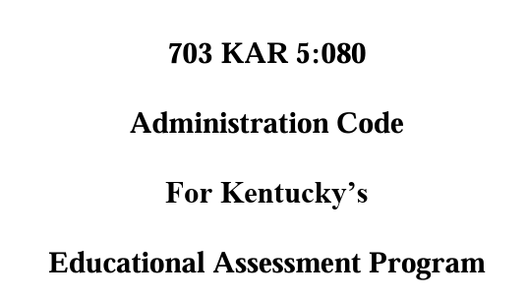

Training Materials
Training materials for the Administration Code regulation include:
Administration Code PowerPoint
Administration Code Videos
Administration Code for Kentucky’s Educational Assessment Program
Notes:
The support materials for this regulation training include Administration Code for Kentucky’s Educational Assessment Program, this PowerPoint and the training videos. These may be accessed on the Assessment Regulations Training webpage. This regulation was updated in August 2024 and this training and documents reflect the most recent updates.

Slide 4
Overview of the Administration Code Regulation
Introduction
Test Security (site visits, data forensics)
Test Preparation (scrimmages, test prep)
Inclusion of Special Populations
Notes:
Kentucky’s assessment and accountability program includes multiple assessments and data reports. This Administration Code shall be followed for all state-required assessments and optional tests administered by school personnel that are reported in Kentucky’s accountability system. This regulation applies to test administrations using paper/pencil and computers/digital technology. The Administration Code shall also be followed for any field test administrations for potentially operational tests.
Throughout the training, we will discuss the rationale, training protocols, test security, test preparation or test prep, the inclusion of special populations, and the alternate assessment. Throughout this presentation, when you see page numbers referenced, they correlate to the page where you can find the information in the regulation.

Slide 5
Introduction

Slide 6
Rationale p.3
Professional Ethics
It shall be considered a violation of this regulation to alter student information (e.g., grade level) or
data in the state student information system in order to access or to avoid testing.
No test preparation practice shall violate the ethical standards of the education profession.
Educational Defensibility
All test preparation practice must be designed and used for increasing student learning.
Any test preparation designed to artificially increase test scores that does not contribute to
students’ overall education are in violation of this regulation.
Student Ownership
All assessment work shall be done entirely by the student.
Students may be asked to read and sign an Honor Code verifying their ownership of their work.
Notes:
The standards used for determining appropriate assessment practices are Professional Ethics, Educational Defensibility, and Student Ownership. Students and schools have the right to valid and reliable test results.
Actions taken by anyone involved with test administration, including designing and using test preparation practice, shall be done to benefit students’ overall learning and not to solely gain a testing advantage.
The assessments are designed for students to demonstrate their understanding. Inappropriate assistance can lead to invalid and unreliable test results, impacting students, parents, schools, and communities. If inappropriate assistance is given, it can compromise the integrity of the test results. This not only affects the individual student's academic record but also has broader implications for parents, schools, and the community at large. Accurate assessments are crucial for making informed decisions about educational strategies and resource allocation, and any compromise in their validity can undermine these efforts.

Slide 7
Appropriate Assessment Practices p.4
Annual interactive training on this Administration Code is required for
every individual involved in any component of the assessment and
should occur before the administration of any state-required assessment.
Any individual providing support for students with disabilities or limited
English proficiency should also be trained on the Inclusion of Special
Populations Regulation(703 KAR 5:070) for appropriate accommodation
practices.
Each test administrator shall complete the signature page found in the
regulation document or sign a group training signature sheet.
Notes:
The Kentucky Department of Education (KDE) is required to have an accountability system that is inclusive of all students and shall hold schools and school districts accountable for the performance of all students.
Anyone with the potential to be involved with any component of state-required testing must be trained on the Administration Code regulation before beginning the work. This could include, but is not limited to, principals, off-grade teachers, substitutes, accommodation providers, librarians, etc. Individuals providing accommodations to students with an IEP, 504, or PSP must also receive training on the Inclusion of Special Populations regulation. Volunteers involved in state testing (such as providing accommodations or helping with proctoring) must meet certain stipulations that also apply to school staff, be trained in both Administration Code and Inclusion of Special Populations and sign non-disclosure agreements. No student may administer a state assessment; this includes peer tutors.
Solely reading the regulation shall not be considered adequate training. Training shall include interaction regarding the content of the regulation with supporting examples and situations. Schools and districts may use materials provided by KDE or locally produced. Once training is completed, test administrators should complete the signature page or sign a group training signature sheet. These should be retained at the district level.

Slide 8
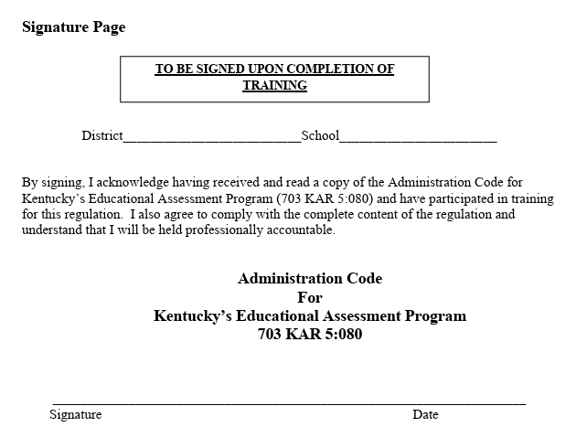
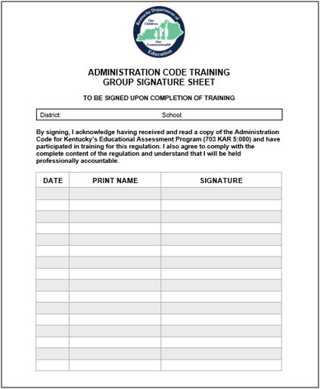
Training Signature Page
Notes:
Districts are charged with maintaining records of individuals receiving Administration Code training. The participants’ records may be maintained through collecting individual signature sheets found on the last page of the Administration Code regulation document or by the retention of group training attendance signature pages. Copies of the signature page or group training attendance sheet may be maintained in hard copy or electronic format. Please make sure you are using the most current version of the signature sheets based on the August 2024 regulation update.
​
A copy of the Group Signature Sheet is available on the KDE website.
​
Training participants are held professionally accountable for their actions after signing either type of signature sheet. Notice that both sheets state: “By signing, I acknowledge having received and read a copy of the Administration Code for Kentucky’s Educational Assessment Program 703 KAR 5:080 and have participated in training for this regulation. I also agree to comply with the complete content of the regulation and understand that I will be held professionally accountable.”
​

Slide 9
Test Security
Notes:
The test security section begins on page 4 of the regulation.

Slide 10
Examples of Secure Materials
Online
Paper/Pencil
Test Tickets
Seal Codes
Scratch Paper
Test Booklets
Answer Documents
Scratch Paper
Notes:
Secure test materials will vary slightly by assessment, but the most common examples are shown on this slide.
For online testing, Test Tickets and Seal Codes created from the PAN system for TestNav, which students use to test, are considered secure materials. Once these items are printed, you must keep them secure until they are distributed on the test day. After the Test Ticket and Seal Codes have been used, they will be returned to the BAC to be securely destroyed.
Paper/pencil tests and accommodated test kits will contain test booklets containing the test questions and answer documents to secure. Sometimes, the test booklet and answer document are combined into one booklet.
Scratch paper is available to students when testing online and in paper/pencil testing formats. Scratch paper is considered a secure material since test questions or answers could be gleaned from these papers. Schools are permitted to print the Test Ticket on a single page so that the student may use the rest of the page as scratch paper, which reduces the amount of paper that must be secured.

Slide 11
Handling Secure Test Materials
Acceptable | Not Acceptable
Distributing Test Administration Manuals to administrators prior to the testing window _{p.6} | Making test booklets (if applicable), student testing tickets, testing seal codes, or any other secure test materials available to test administrators before the first scheduled day of testing. _{p.6}
Using school-managed testing computers or devices during testing as well as any devices specified for accommodation purposes in the student’s Individual Education Plan, Program Services Plan, or 504 Plan. _{p.6} | Storing secure test materials in any location that is not double-locked (such as lockable storage inside a locked room) or leaving secure test materials outside of locked storage unattended. _{p.6}
All persons helping with testing, including technical support staff, must sign a nondisclosure agreement (NDA) form each calendar year. _{p.5} | Reproducing secure test materials in whole or in part or paraphrasing in any way, including discussing, e-mailing, photocopying, photographing, scanning, handwriting, typing, saving to shared cloud-based drives (e.g., Google drive) or posting to social media or other Internet sites. _{p.6-7}
Notes:
Let’s look at acceptable and not acceptable practices when handling secure testing materials.
Pages 5 through 7 in the Administration Code regulation contains the Test Materials section, divided into the Acceptable and Not Acceptable columns.
Test administrators need test administration manuals in advance of testing to read and prepare for test sessions. Following test manual directions and reading the scripts aloud is essential for a successful, standardized administration and avoiding an allegation. Scripts are updated yearly and are unique to each assessment. Reading all parts of the script ensures that the student’s test results are valid and reliable.
Only school managed testing computers or devices, including any devices used for accommodation purposes in a student’s individual plan, may be used for assessment administration. All persons helping with testing, including technical support staff, must sign a nondisclosure form each calendar year. The addition of technical support staff is new in the 2024 update. Any volunteers or substitutes helping with testing are also required to sign a non-disclosure form. Nondisclosure forms can be found on the KDE website.
It is Not Acceptable to make any secure test materials including test booklets, student testing tickets, seal codes, or other materials available to test administrators before the first scheduled day of testing.
When not being used for a scheduled testing session, all assessment materials shall be stored in a double-locked secure location with access granted to authorized personnel only and should never be left outside of that double-locked storage. This includes materials used for offsite testing. If secure test materials such as seal codes or student test tickets are found written on the board of a classroom, sitting on a desk, or even laying in the hallway, that will have to be reported as an allegation.
It is not acceptable to reproduce secure test materials in any way; this includes discussing, emailing, photographing, writing, typing, saving to a cloud-based drive such as a Google drive, or posting to any internet sites.
Let’s continue with more Confidential Test Content.

Slide 12
Handling of Secure Test Materials (continued)
Acceptable | Not Acceptable
Test materials may be taken from school or district buildings by trained staff to administer the test to homebound/hospitalized students or for offsite group administrations approved by KDE or the test vendor. _{p.5} | Deliberately reviewing or reading secure test item content, revealing secure test item content to anyone, or using it for test prep _{p.5}
Students using technology to respond to test items are allowed to save responses to temporary digital devices but not to cloud-based or other drives or servers. _{p.5} | Scoring secure test items, pre-writing areas, or drafts or maintaining electronic versions of secure test materials _{p.5}
Collecting and destroying (i.e. shredding) student testing tickets, seal codes, notes, rough drafts or scratch paper produced by students during testing _{p.5} | Taking test materials outside district or school buildings for purposes such as bubbling demographics or modifying materials for students in the Alternate Assessment program. _{p.5}
Notes:
There are times when test materials may need to be taken from a school for off-site testing. This may include computers, paper test books, etc.
Test security must be maintained while transporting materials used for home/hospital administration or off-site administration. Leaving materials with students in a home/hospital setting is unacceptable. Secure materials must always be under the guardianship of trained staff.
Offsite testing is an acceptable practice with online and paper testing. As a reminder, in-person online testing can only be conducted by trained staff. Please ensure the testing environment is free of content related to the test, only the student and trained staff are present, and the student does not have additional internet devices in the room. No test administration may occur via online meeting services such as Google Meet, Zoom, Microsoft Teams, etc.
Students utilizing paper/pencil testing may be using nonstandard response modes, such as Braille responses, which may be maintained temporarily to ensure that responses are not lost prior to the return shipment of printed responses with secure test materials. After testing is complete and student responses have been prepared for return shipment, any nonstandard versions are to be deleted/destroyed. The test administration manual for each assessment will give instructions on collection, destruction, or return of secure test materials. Maintenance of these materials after the test window is an Administration Code violation.
We’ve covered the Acceptable practices; let’s look at the Not Acceptable practices concerning secure test materials.
It is unacceptable to take test materials out of the school or district building for any reason, except for approved off-site testing. Bubbling demographics or modifying materials for the Alternate Assessment shall be completed on school property. Any secure test items, pre-writing areas, drafts, or electronic versions should not be scored or maintained. Lastly, a student shouldn’t transport or move his/her test materials from one location to another without being escorted or monitored by trained testing staff. For example, a student receiving extended time needs to move to another room to complete the assessment. An adult who has received Administration Code training should transport and escort the student to the secondary location to finish.

Slide 13
Monitoring Test Security: Data Forensics
Score analysis can lead to the discovery of inappropriate practices such as:
Cheat sheets
Test administrators leading students to answers through physical or verbal cues or providing inappropriate accommodations
Adults changing student answers
Locating secure test items that have been published on social media sites or entered into artificial intelligence (AI) databases
Notes:
KDE employs vendors who specialize in various data forensics techniques as part of its test monitoring process. The purpose is to examine inconsistencies that could indicate wrongdoing and investigate as needed. The investigation could be used to absolve suspected misconduct.
Some discoveries of inappropriate practices can be cheat sheets, adults changing student answers, or students receiving help or verbal cues from administrators. Data forensics also help locate secure test items that may have been published on social media sites, released as part of test prep materials, or entered into artificial intelligence databases.

Slide 14
Monitoring Test Security: OAA Site Visits
OAA Site Visits
Visits are conducted during testing windows.
Sites are chosen by both purposeful and random selection.
DACs are notified shortly before arrival. DACs may notify schools and attend.
OAA Staff will request to see testing and storage areas and will collect specific documents (e.g., seating charts, test schedules, Good Faith Effort Check Sheets).
Notes:
The US Department of Education requires states to demonstrate the technical soundness of their assessment system. Part of this process is site visit monitoring.
Each year, staff from the OAA visit schools during the testing windows. The visits are announced to the District Assessment Coordinator (DAC) shortly before the team arrives at the school building. Sites are chosen by both purposeful and random selection.
OAA staff will interview school and district staff and request to see storage and testing areas. During the interview process, staff present may include the DAC, BAC, Principal, and anyone familiar with the assessment being monitored. For the spring KSA visits, this also includes the AKSA. Certain documents are also collected at the time of the visit. Any situation that violates the Administration Code or Inclusion of Special Populations regulations is reported as an allegation.
Allegations are investigated by KDE staff. The investigations require documentation of the incident to be submitted and can include additional school visits and interviews with those involved.

Slide 15
Allegation Prevention/Best Practices (1)
Make sure all seal codes are erased from boards and student test tickets are collected and returned to the BAC for secure destruction after a test session.
Double check the student test tickets to be sure each student has the correct ticket before allowing students to sign in to the assessment.
Do not allow students to carry or handle test tickets outside the test session without being monitored the entire time by trained testing staff; this includes allowing student office aides to deliver tickets.
Notes:
This is one of several slides containing suggestions based on past reports that will help prevent future allegations. Every year, several allegations happen surrounding secure test items. If you have written a seal code on the board, please erase it after the test session. Make sure all student test tickets are collected and returned to the BAC. Do not allow them to be left in the classroom, dropped in the hallway, etc.
Sometimes, students may receive the wrong test ticket. Have the proctor double check them to be sure the ticket matches the student.
Finally, please do not allow students to carry or handle their test tickets outside of the testing session if they are not being actively monitored by trained testing staff. This includes allowing student office aides to deliver test tickets to rooms.

Slide 16
Check for Understanding (1)
1. Is it acceptable to take photos of test items for use in designing instructional materials to know you are teaching the correct content?
2. Is it acceptable for testing staff to receive or access Test Administration Manuals prior to the first day of testing?
3. Is it acceptable to read only the bold type instruction script
in TAMS and scripts and skip the test administrator directions
if you have been a test administrator in previous years?
4. Is it acceptable to administer a state assessment for
a virtual or home/hospital student using Google Meet,
Zoom, Teams, etc.?
Notes:
It’s time for our Check for Understanding. I’ll read through these Yes or No questions and discuss the answers.
1. Is it acceptable to take photos of test items for use next year to know you are teaching the correct content?
(NO) It is unacceptable to take pictures of test items for use next year to teach the correct content. Concepts appropriate for curriculum instruction can be found in Kentucky’s content standards. Test administrators may use released test items and support materials posted on the KDE website to help prepare students for the assessment. (pp. 6-7, 5)
2. Is it acceptable for testing staff to receive or access Test Administration Manuals (TAMs) prior to the first day of testing?
(YES) It is acceptable for testing staff to receive paper or electronic Test Administration Manuals (TAMs) prior to the first day of testing. Other secure test items may not be distributed until the test session. (p. 6)
3. Is it acceptable to read only the bold type instruction script in the TAMs and skip the test administrator directions if you have been a test administrator in previous years?
(NO) It is not acceptable to read only the bold type instruction script in the TAMs and skip the test administrator directions for those who have been test administrators in previous years. Test manuals and scripts are updated yearly. (p. 4)
4. Is it acceptable to administer a state assessment for a virtual or home/hospital student using Google Meet, Zoom, Teams, etc.?
(NO) All state testing must be administered in-person by trained personnel. The reference to “online testing” refers to the test platform, not the delivery method. Page 10 of the regulation states that “Test Administrators shall be physically present in the testing environment while students are actively testing. “

Slide 17
Division of Assessment and Accountability Support
Contact Information
KDE DAC Information dacinfo@education.ky.gov (502) 564-4394
Notes:
This concludes Module 1. Please proceed through all five modules for the complete training.
If you have questions, please contact KDE DAC Information, dacinfo@education.ky.gov, or call 502-564-4394.

